Slide 1

Speech Synthesis
6th Sem - AIE

Slide 2

What is Speech Synthesis ?
Speech synthesis is the process of automatically generating a speech signal from a written text input.

Slide 3
Comparison of Text Systems
Aspect | Limited Text Systems | Unrestricted Text Systems
Vocabulary Constraints | ✔️ | ❌
Input Flexibility | ❌ | ✔️
User Experience | Limited | Enhanced
Application Scope | Restricted | Evolving

Slide 4
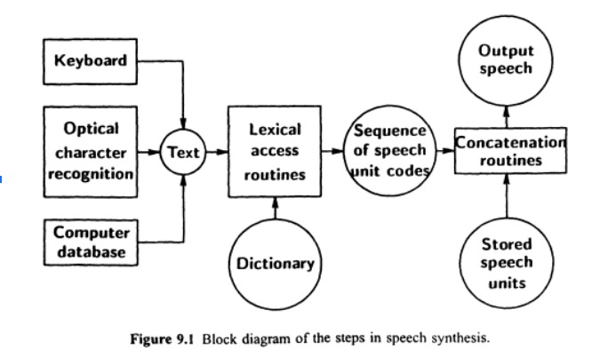
Steps in Speech Synthesis

Slide 5

Synthesizer Methods
Today we’ll be going over 3 different methods of Speech Synthesis : a) Articulatory Synthesis
b) Format Synthesis
c) Linear Predictive Coding

Slide 6
Articulatory Synthesis
Articulatory synthesis is a method of speech synthesis that attempts to simulate the human vocal tract and its articulatory movements involved in speech production.
Model
Simulate
Reshape

Slide 7
Articulatory Synthesis
Advantages
Enables control over parameters for natural speech.
Develops understanding of speech production physiology.
Challenges
Creating precise articulatory models is complex and needs high computation.
Model parameter tuning needs expert knowledge.

Slide 8
Format Synthesis
Formant synthesis is a method of speech synthesis based on the manipulation of formants, which are resonant frequencies in the vocal tract.
Wave Generation
Filter & Combine
Adjust

Slide 9
Format Synthesis
Advantages
Can produce intelligible speech.
Control over individual formants.
Challenges
lacks the naturalness and expressiveness .
Fine-tuning the formant parameters to achieve natural-sounding speech is challenging.

Slide 10
Linear Predictive Coding (LPC)
Linear Predictive Coding is a method commonly used in speech processing for representing the spectral envelope of a speech signal. It models the speech signal as the output of a linear filter driven by a sequence of input samples.
Analysis
Estimation
Prediction
Synthesis

Slide 11
Linear Predictive Coding (LPC)
Advantages
Provides a compact representation of speech signals, making it suitable for compression and transmission.
Low computational complexity.
Challenges
Performance can degrade in noisy environments or with rapidly changing speech characteristics.
Fine-tuning LPC parameters for optimal speech synthesis may require expertise.

Slide 12
Synthesis of Intonation

Slide 13
Intonation
The synthesis of intonation refers to the process of generating the pitch contour or melody of speech. Intonation conveys linguistic and emotional information and plays a crucial role in speech perception and comprehension.
Methods:
Prosodic synthesis techniques, such as pitch contour modelling and prosody prediction.
Statistical models, rule-based systems, and machine learning approaches can be employed to generate intonation patterns based on linguistic and contextual factors.
Concatenative synthesis methods combine pre-recorded speech segments with varying intonation patterns to create natural-sounding speech.

Slide 14
Considerations
Synthesizing natural intonation involves capturing nuances such as pitch variation, stress patterns, and rhythmic elements.
Contextual factors, such as sentence structure, discourse type, and speaker characteristics, influence intonation and must be considered in synthesis.

Slide 15
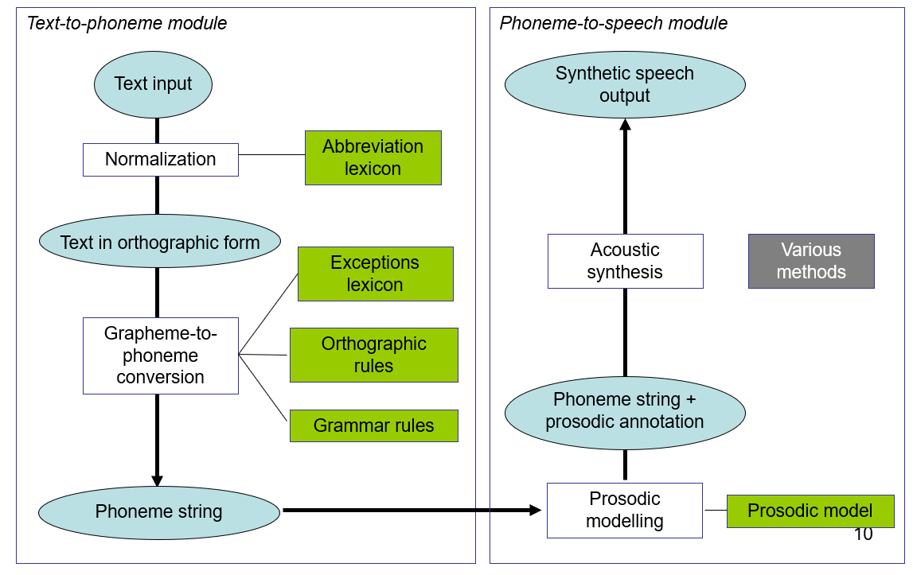

TTS Architecture

Slide 16
Limitations
Robotic Sound
Accent & Pronunciation
Emotional Nuance
Contextual Understanding

